Slide 1

TITANIC DISASTER ANALYSIS
Under the guidance of: Prof. Pranali Kosamkar
Presented to you by:
Anish tatke PA09
Arpit Patil PA14
Anuj Khot PA43
Nancy Vachhani PA56
Madhura Patil PA61

Slide 2
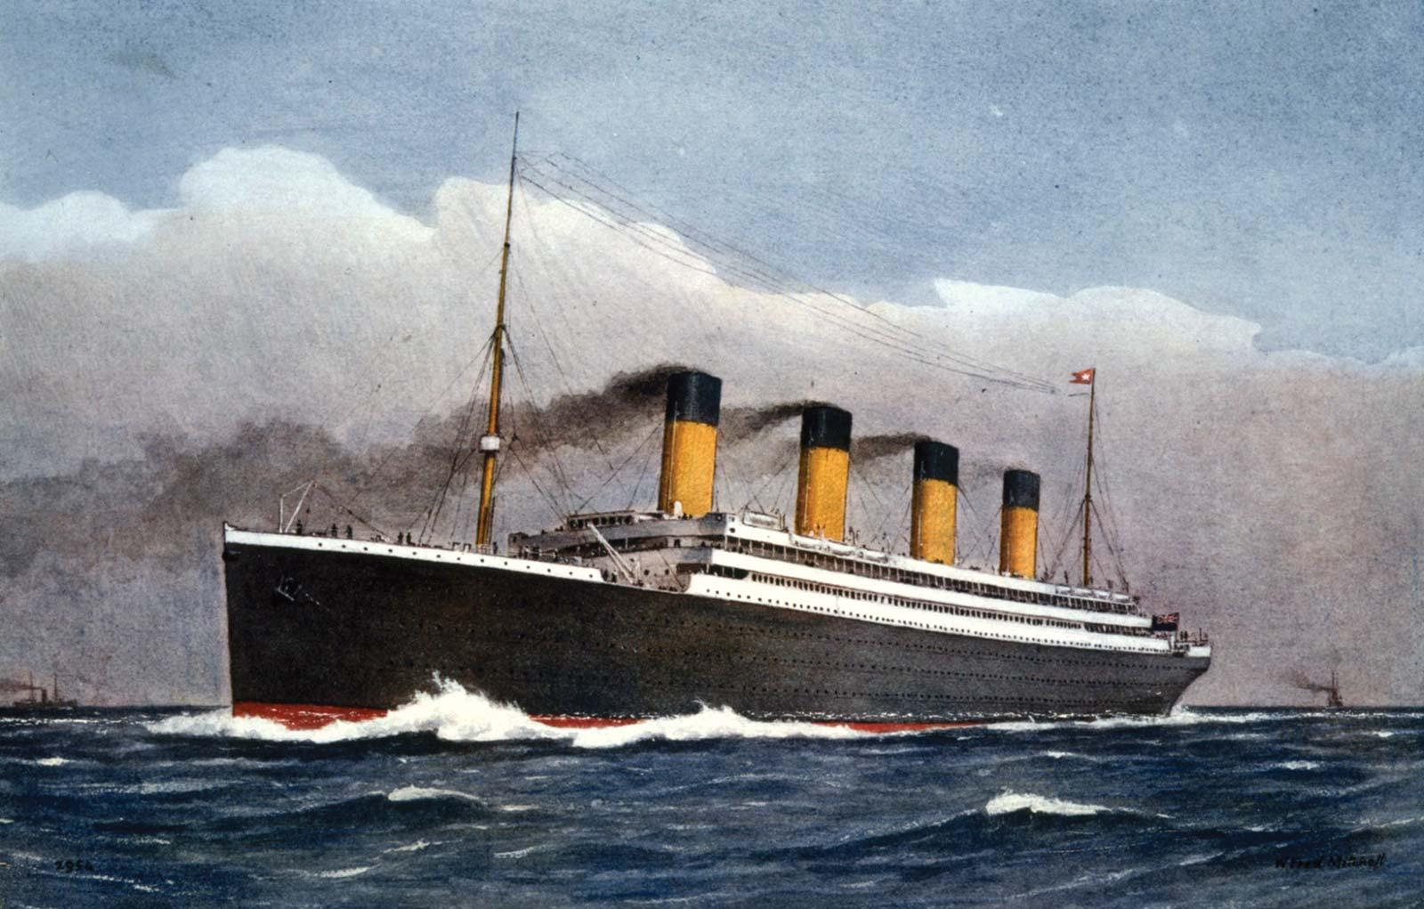
Abstract
The most infamous disaster which occurred over a century ago on April 15, 1912, that is well known as sinking of “The Titanic”. The collision with the iceberg ripped off many parts of the Titanic. Many classes of people of all ages and gender where present on that fateful night.
The objective is to perform various database operations on the chosen dataset and illustrate visualizations using suitable tools.
Machine learning algorithms are applied to make a prediction which passengers survived at the time of sinking of the Titanic.
Using the machine learning algorithms, survival is predicted on different combinations of features.

Slide 3

DATA OVERVIEW
The data has been split into two groups:
training data set
test data set
The training data is used to demonstrate query operations, aggregation method, map reduce, and machine learning algorithms.
Outcome i.e "ground truth" is provided for each passenger in the training set data.
The test set is used to see how the operations and algorithms are performed.

Slide 4
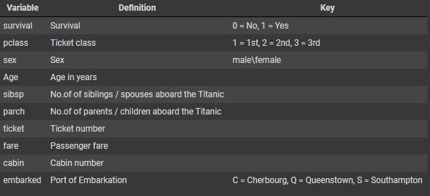
Data Dictionary
The Data dictionary explains the columns of the dataset and what it defines. From this we can understand how one column might be dependent on other columns

Slide 5
Operations to perform
Pymongo connectivity and CRUD operations applied on the original csv file to create the updated csv file.
Query retrieval
Aggregation pipeline method
Map reduce function using MongoDB
Machine learning algorithms(regression and classification)
Visualization

Slide 6
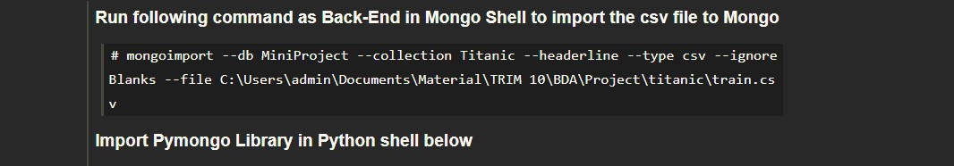
Importing Data:
The following line imports the data from csv file to the MongoDB database. This command is run in the Mongo Shell with the following parameters to import the data.
The data is converted from csv format to MongoDB compatible format[BSON].

Slide 7
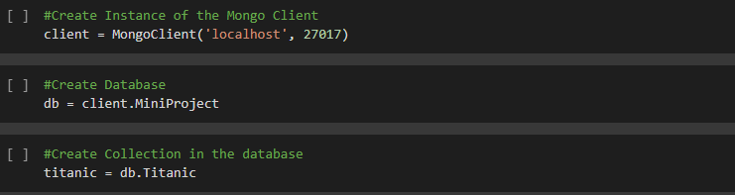
Pymongo connectivity
Create operations to create client instance, database and collection. We are sing the ‘pymongo’ library to connect the database with Python as front-end.

Slide 8
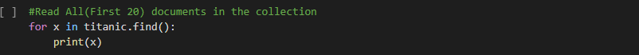
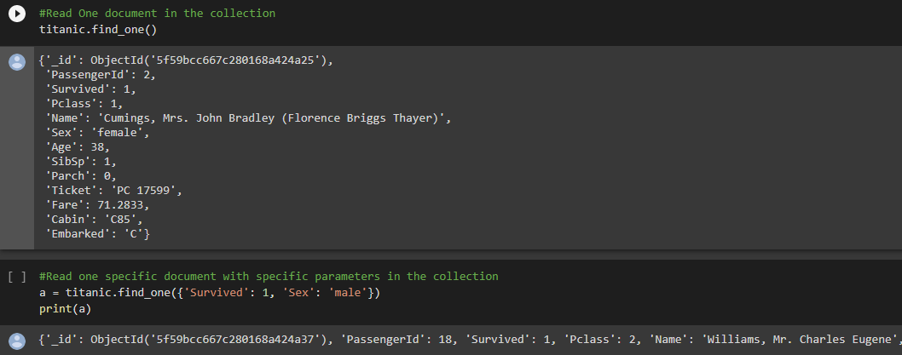
Reading documents in the collection
Read operation to read documents from the collection. Below performed are three different read operations: Read All documents, Read One document, Find documents according to specific parameters and read them. We use the ‘find()’ from Pymongo.

Slide 9
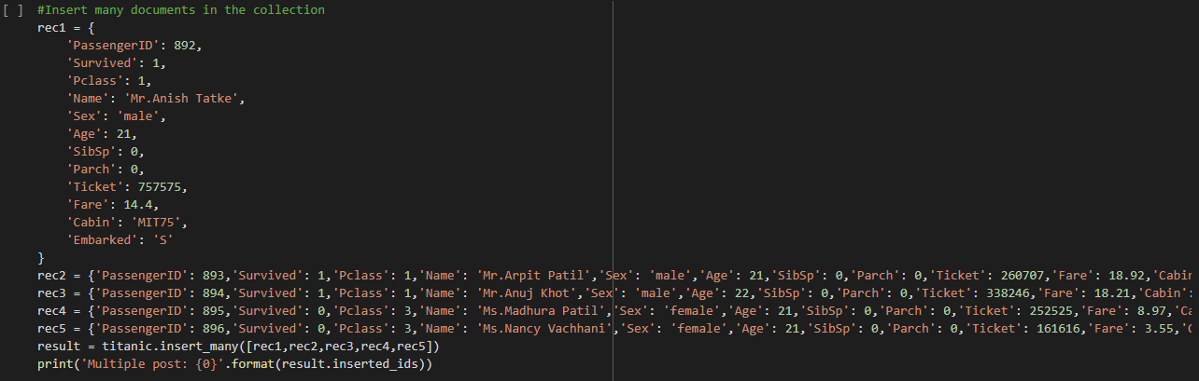
Inserting documents
We insert five new hard-coded documents in the database by using the ‘insert_many()’ from Pymongo

Slide 10
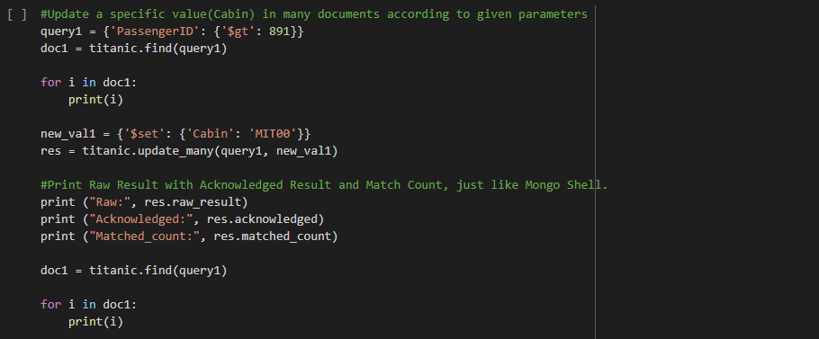
Updating records
We can update the specific attributes/values in the documents by running the ‘update_one()’ and ‘update_many()’ functions. Both functions take two parameters, one for finding the document from specific parameters and other for setting new values for the attribute in that document

Slide 11
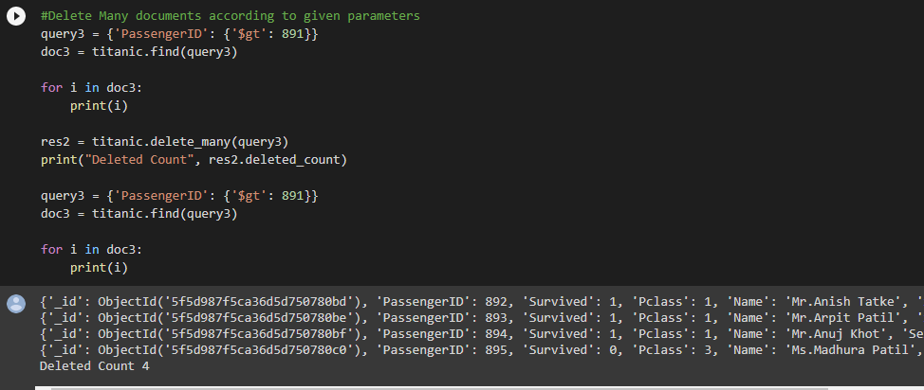
Deletion of records
We also use the delete operation to delete one or many documents at a time. Two functions namely ‘delete_one()’ and ‘delete_many()’ are used to do so

Slide 12
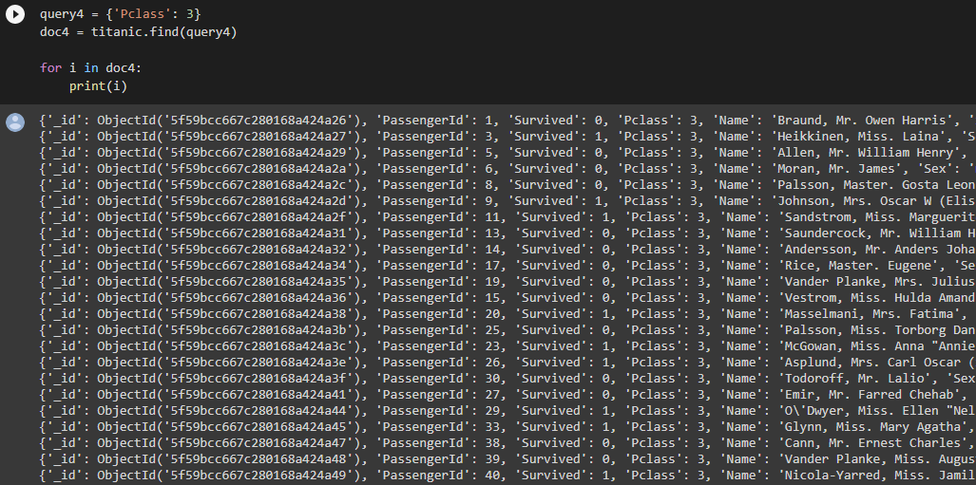
Query retrieval
Query Retrieval is the process of finding data in the database using complex queries that specify parameters according to the question asked by user. These queries then returns the data.

Slide 13
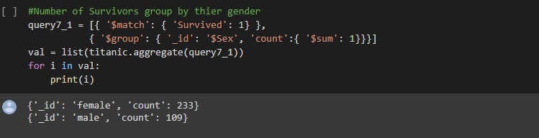
Aggregation pipeline method
Aggregation pipeline is a type of query retrieval process that uses complex MongoDB functions to get specific data from the dataset. The pipeline is a linear link of functions where input to each function from start is the output of the next function.
This method uses many functions like $match, $project, $sort, $group, etc.

Slide 14
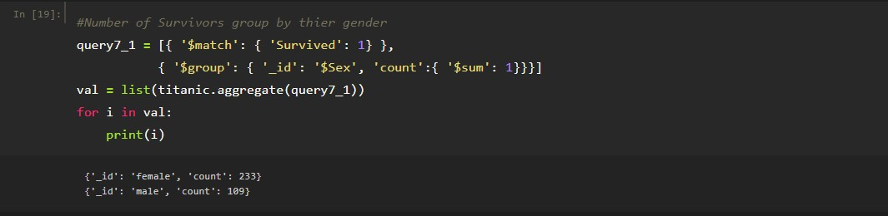
The below given image shows use of methods ‘$match’ and ‘$group’:
$match: This function matches the specific value from database. Here we can use comparison operators to find values according to a given threshold.
$group: This function groups the data by by a specific variable. For example in the below image, the function groups the data by the gender of the passenger.

Slide 15
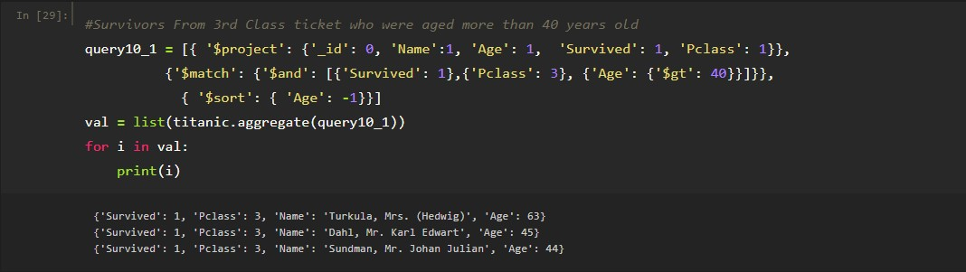
The below given image shows the use of methods:
$project: This function is used to project the data. It decides which data is to be projected and which data is to be hidden in the output of the pipeline.
{‘_id’ : 0, ‘Name’: 1} : Here ‘id’ is not shown as it is 0 but Name is shown as it is 1.
$sort: This function is used to sort the output according to a given parameter. (1) sorts in ascending order and (-1) sorts in descending order.

Slide 16
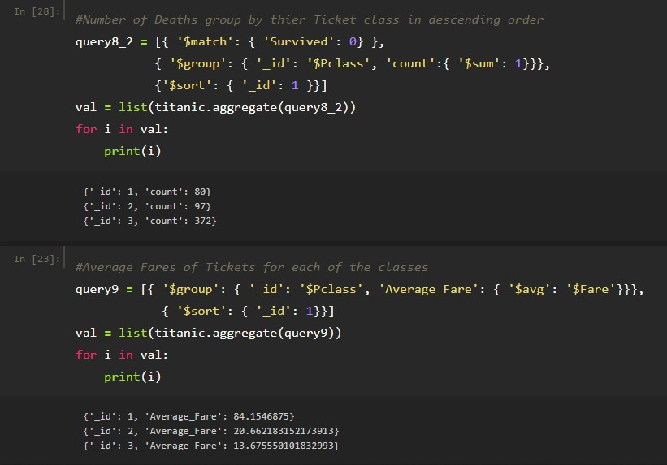
Some more Aggregation Pipeline examples:

Slide 17
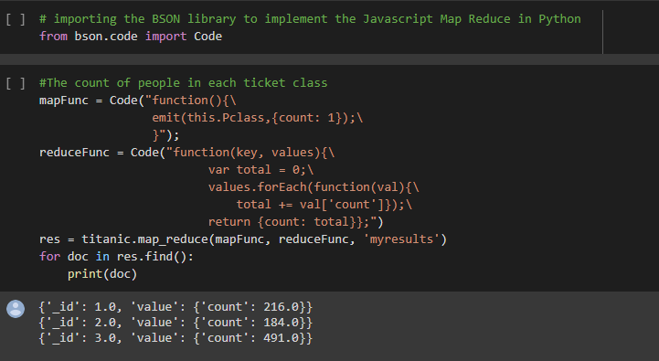
Map reduce function using MongoDB
Map-Reduce is a technique used to process and generate Big Data sets with parallel , distributed implementation on cluster.

Slide 18
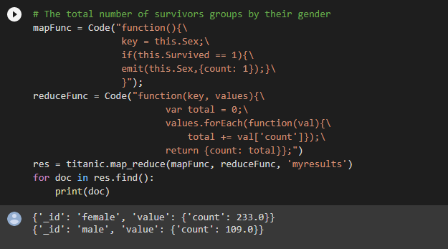
Map-Reduce can be implemented by many applications like Hadoop, MongoDB, etc. Here we are using MongoDB implementation of Map-Reduce in Python.
We import the ‘bson.code’ library and use the Code function to write the code in it.

Slide 19
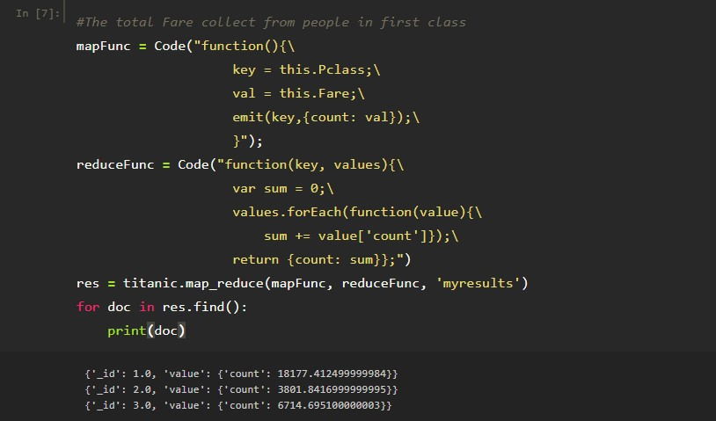
The Map_Reduce technique is split into two parts: the map function is used to split the data and assign it in ‘n’ different parts. The reduce function performs the query on those ‘n’ different parts and returns the result.

Slide 20
Machine Learning
The Titanic dataset has two import patterns that can be learnt to predict values.
Data Preprocessing : The data is very inconsistent hence it needs preprocessing. After this step all the missing values as well as categorical variables are handled
Regression : We can the predict the values of “Fares” of the Passengers from the test set based on the information from the training set.
Classification : We can predict which passengers from test set survived and which died by learning from the training set

Slide 21
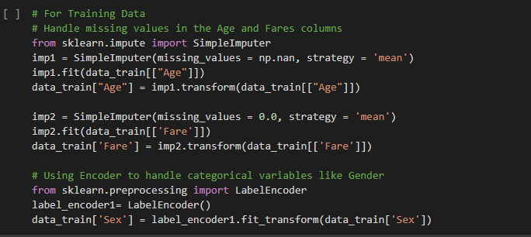

Data preprocessing

Slide 22
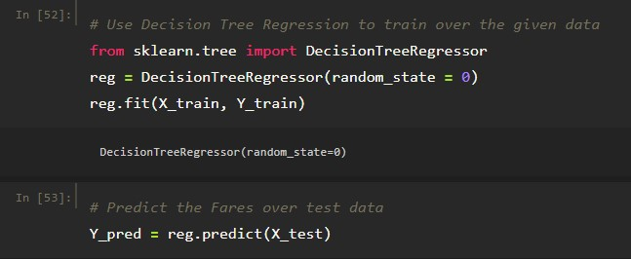
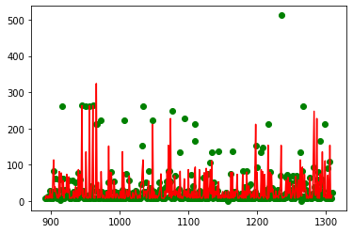
Regression: Decision tree
We use the Decision Tree Regression Method to learnt from the values over training set. We learn from the features like [Pclass, Sex, Age, Parch, SibSp, Fares]. Then we predict the values of Fares of passengers from Test set.

Slide 23
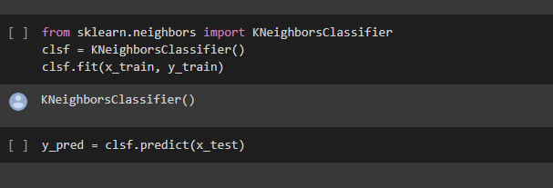
Classification
We use the K Nearest Neighbours Algorithm to learnt from the training data and predict if the passenger survived or not from test data. We use the sklearn’s KNeighboursClassifier to fit over the training data. Then we predict the values on test data.

Slide 24
Plots
We use the D3 as well as the Seaborn library in Python to plot visualizations of the data to find meaningful pattern in them.
Line Plot
Bar Plot
Histograms
Regression Plots
Pie Charts
Box Plots
Scatter Plots

Slide 25
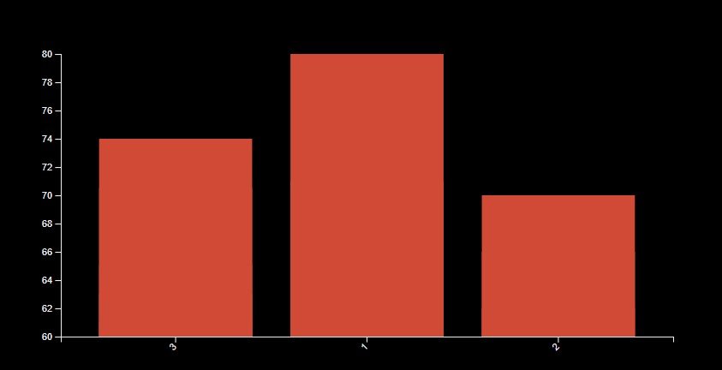
Plots using D3 and Angular:
Bar Plot: This shows the relation of the ages of people according to different ticket class.

Slide 26
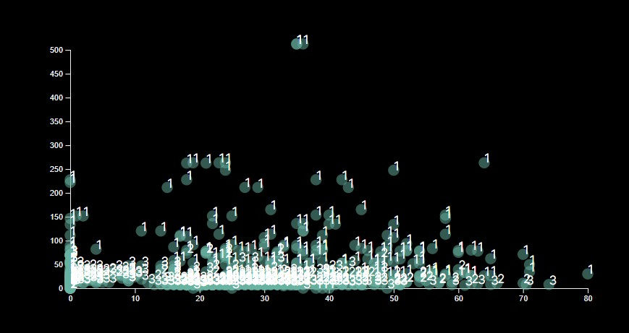
Scatter Plot: The below image shows the scatter plot of Ages of people and their Fares. The plot is classified according to the ticket class.

Slide 27
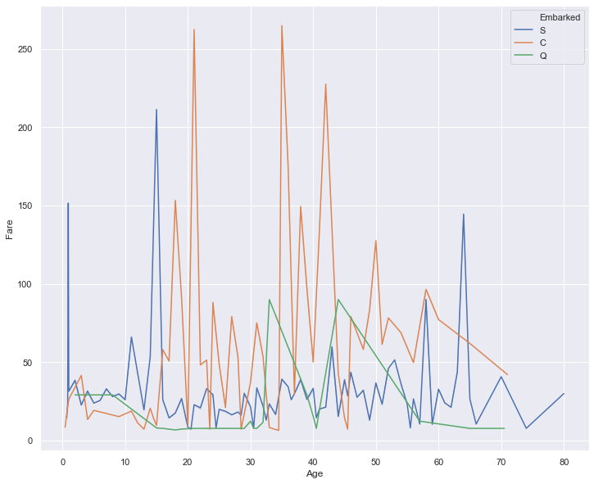
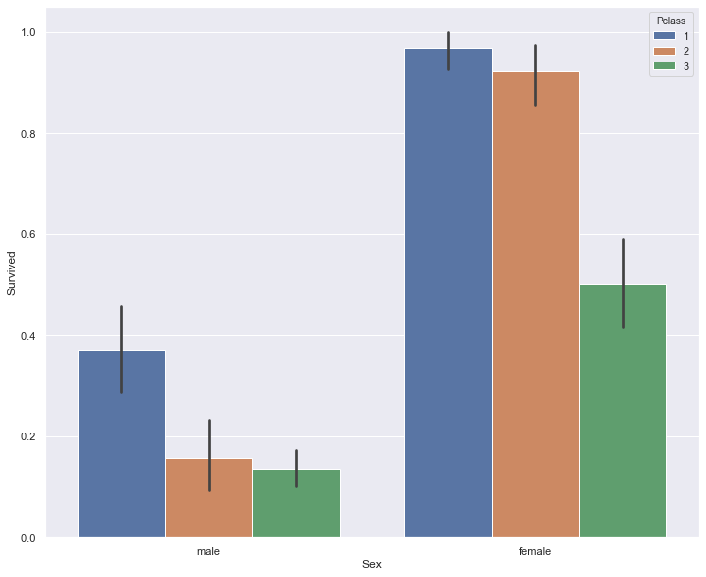
Plots done by Seaborn in Python:
Bar Plot: Shows the number of people survived from each gender with classification from ticket class.
Line Plot: Shows relation between Age and Fare classified by port of Embarkation

Slide 28
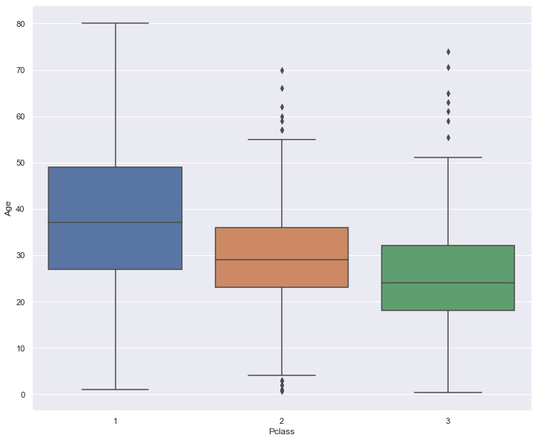
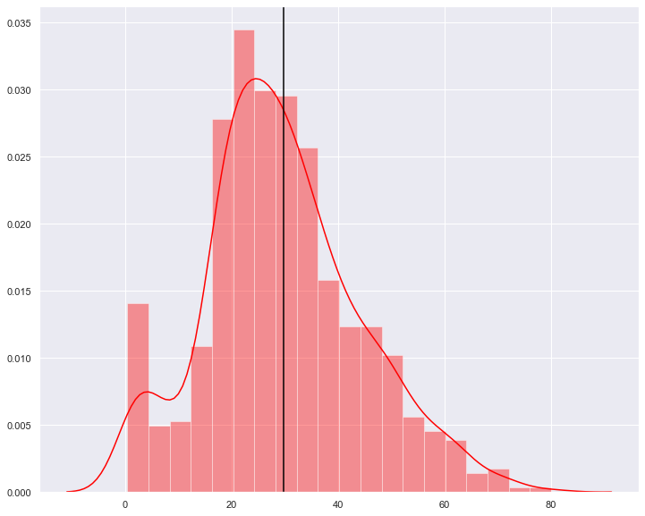
Histogram: Distribution of Age of people aboard the Titanic.
Box Plot: Shows the Box plot of people in different ticket class according to their Age.

Slide 29
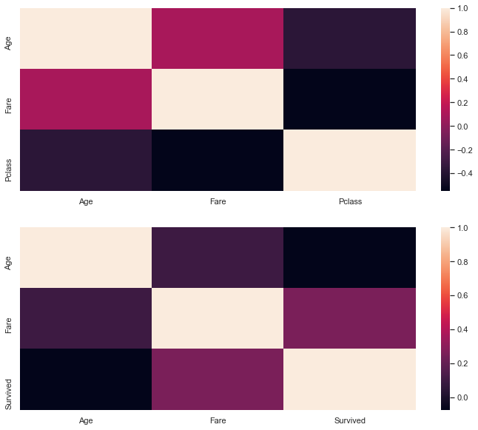
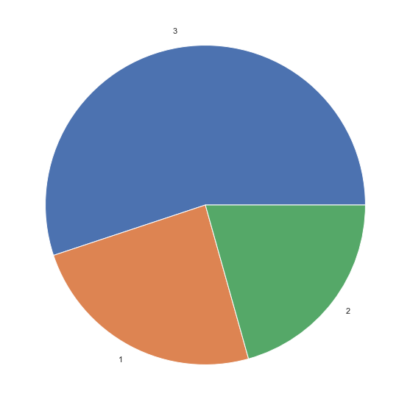
Pie Chart: Shows the distribution of people according to the ticket class
HeatMap: The heatmap of Age, Fare and people survived, the heatmap of Age, Fare and ticket class.

Slide 30
Conclusion
Successfully able to predict the survivals on the basis of features using machine learning algorithms.
Able to fetch data from mongodb by applying various operations using python.
Able to visualise the data according to different conditions applied in D3 and matplotlib and seaborn.
With the help of aggregation pipeline method and map reduce function data can be grouped according to different conditions.

Slide 31
Thank you!

